Slide 1

Course – TFC
Course Instructor
Dr. Umadevi V
Department of CSE, BMSCE
Webpage:https://sites.google.com/site/drvumadevi/

Slide 2
Unit-4
Pushdown Automata
Definition of the Pushdown Automaton, The Languages of a PDA, Equivalence of PDA’s and CFG’s , Deterministic Pushdown Automata,
The Pumping Lemma for Context Free Languages, Closure Properties of Context Free Languages

Slide 3
Push Down Automata (PDA)
Pushdown Automata is a finite automata with extra memory called stack which helps Pushdown automata to recognize Context Free Languages.

Slide 4
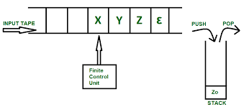
Schematic Representation of PDA Rough Slide

Slide 5
Schematic Representation of PDA Rough Slide
Example: L={a^{n}b^{n}, n>=1}
Valid String “aabb”
Input
a | a | b | b | 𝞮
 |  |  |  |  | z₀
Stack

Slide 6
Schematic Representation of PDA Rough Slide
Example: L={a^{n}b^{n}, n>=1}
Valid String “aabb” Invalid String “aabbb”
Input
a | a | b | b | 𝞮
 |  |  |  |  | a
 |  |  |  |  | a
 |  |  |  |  | z₀
Input
a | a | b | b | b | 𝞮
 |  |  |  |  |  | z₀
Stack
Stack

Slide 7
Schematic Representation of PDA
Example: L={a^{n}b^{n}, n>=1}
Valid String “aabb” Invalid String “aabbb”
Input
a | a | b | b | 𝞮
 |  |  |  |  | a
 |  |  |  |  | a
 |  |  |  |  | z₀
Input
a | a | b | b | b | 𝞮
 |  |  |  |  |  | a
 |  |  |  |  |  | a
 |  |  |  |  |  | z₀
Stack
Stack

Slide 8
Formal Definition of PDA
P=(Q, ∑ , Γ , q₀, Z₀, δ, F)
Q is the set of states
∑ is the set of input alphabet
Γ is the set of symbols called stack alphabet
q₀ ∈ Q , is the initial state
Z₀ ∈ Γ, is the initial symbol on the stack
F is the set of final states
δ is a transition function which maps Q x {Σ ∪ ε} x Γ into Q x Γ*. In a given state, PDA will read input symbol and stack symbol (top of the stack) and move to a new state and change the symbol of stack.
δ(State, Input Symbol, Stack Symbol)=(Next State, Stack Symbol)

Slide 9
Classification of Push Down Automata
Deterministic Push Down Automata (DPDA)
Non-Deterministic Push Down Automata (NPDA)
Note: Unlike Finite Automata, DPDA and NPDA are not equivalent. For example, the language
L={WW^{R}, W ∈(a+b)*) } is accepted by NPDA but not by any DPDA

Slide 10
Two ways a PDA accept the language
There are two ways a PDA can accept the language:
Empty Stack: If a sentence in a language causes PDA to empty its stack then the sentence is accepted.
Final State: If a sentence in a language causes PDA to move to a state which is member of a set of final states, then the sentence is accepted.

Slide 11
Question
Construct PDA ( or DPDA) to recognize the language L={a^{n}b^{n}, n>=1} by empty stack method. Show the moves made by PDA for the string aabb and aaabb

Slide 12
Construct PDA ( or DPDA) to recognize the language L={a^{n}b^{n}, n>=1} by empty stack method. Rough Slide
Construct PDA ( or DPDA) to recognize the language L={a^{n}b^{n}, n>=1} by empty stack method. Show the moves made by PDA for the string aabb and aaabb
States | Stack Top Symbol | Input Symbols
 |  | a | b | 𝞮
q₀ | z₀
 | a
q₁ | z₀
 | a

Slide 13
Construct PDA ( or DPDA) to recognize the language L={a^{n}b^{n}, n>=1} by empty stack method.
Construct PDA ( or DPDA) to recognize the language L={a^{n}b^{n}, n>=1} by empty stack method. Show the moves made by PDA for the string aabb and aaabb
States | Stack Top Symbol | Input Symbols
 |  | a | b | 𝞮
q₀ | z₀ | Push a q₀ | X | X
 | a | Push a q₀ | Pop a q₁ | X
q₁ | z₀ | X | X | Pop Z₀ q₁
 | a | X | Pop a q₁ | X

Slide 14
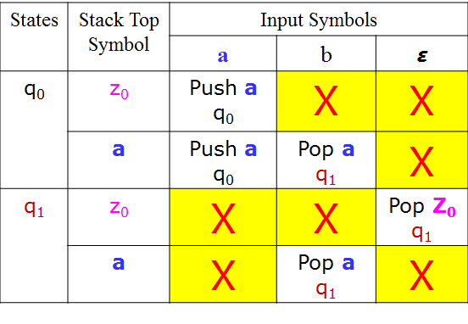
Construct PDA ( or DPDA) to recognize the language L={a^{n}b^{n}, n>=1} by empty stack method.
Representing PDA as a generalized
Transition Diagram
a, z₀ | az₀
b, a | 𝞮
q₀
b, a | 𝞮
q₁
a, a | aa
𝞮, Z₀ | 𝞮

Slide 15
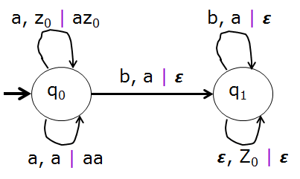
Construct PDA ( or DPDA) to recognize the language L={a^{n}b^{n}, n>=1} by empty stack method.
Formal definition of PDA
P=(Q, ∑ , Γ , q₀, Z₀, δ, F)
Q = { q₀ , q₁ }
∑ = {a, b}
Γ ={a, Z₀}
q₀ = q₀
Z₀ = Z₀
F = { }
δ(q₀ , a, z₀) =(q₀ , az₀)
δ(q₀ , a, a) =(q₀ , aa)
δ(q₀ , b, a) =(q₁ , 𝞮)
δ(q₁ , b, a) =(q₁ , 𝞮)
δ(q₁ , 𝞮, z₀) =(q₁ , 𝞮)
Push Operation
Pop Operation

Slide 16
Instantaneous Description of a PDA Rough Slide
The current configuration of PDA at any given instant can be described by Instantaneous Description (ID).
An ID gives current state of PDA, the remaining string to be processed and the entire contents of stack.
Instantaneous Description for the string "aabb"
(q₀, aabb, z₀)

Slide 17
Instantaneous Description of a PDA
The current configuration of PDA at any given instant can be described by Instantaneous Description (ID).
An ID gives current state of PDA, the remaining string to be processed and the entire contents of stack.
Instantaneous Description for the string "aabb"
(q₀, aabb, z₀) ˫ (q₀, abb, az₀)
˫ (q₀, bb, aaz₀)
˫ (q₁, b, az₀)
˫ (q₁, 𝞮, z₀)
˫ (q₁, 𝞮, 𝞮)
All the Input symbols
are read and Stack is empty,
therefore the string “aabb” is
Accepted.

Slide 18
Instantaneous Description of a PDA Rough Slide
Instantaneous Description for the string "aaabb"
(q₀, aaabb, z₀)

Slide 19
Instantaneous Description of a PDA
Instantaneous Description for the string "aaabb"
(q₀, aaabb, z₀) ˫ (q₀, aabb, az₀)
˫ (q₀, abb, aaz₀)
˫ (q₁, bb, aaaz₀)
˫ (q₁, b, aaz₀)
˫ (q₁, 𝞮, az₀)
All the Input symbols
are read but the Stack is
not empty, therefore the string
“aaabb” is not accepted.

Slide 20
Question
Construct PDA ( or DPDA) to recognize the language L={a^{n}b^{2n}, n>=1} by empty stack method. Give the graphical representation of the PDA obtained. Show the moves made by PDA for the string aabbbb and aabbb

Slide 21
Construct PDA ( or DPDA) to recognize the language L={a^{n}b^{2n}, n>=1} by empty stack method. Rough Slide
States | Stack Top Symbol | Input Symbols
 |  | a | b | 𝞮
q₀ | z₀
 | a
q₁ | z₀
 | a

Slide 22
Construct PDA ( or DPDA) to recognize the language L={a^{n}b^{2n}, n>=1} by empty stack method.
States | Stack Top Symbol | Input Symbols
 |  | a | b | 𝞮
q₀ | z₀ | Push aa q₀ | X | X
 | a | Push aa q₀ | Pop a q₁ | X
q₁ | z₀ | X | X | Pop Z₀ q₁
 | a | X | Pop a q₁ | X
Representing PDA as a generalized
Transition Diagram
a, z₀ | aaz₀
b, a | 𝞮
q₀
b, a | 𝞮
q₁
a, a | aaa
𝞮, Z₀ | 𝞮

Slide 23
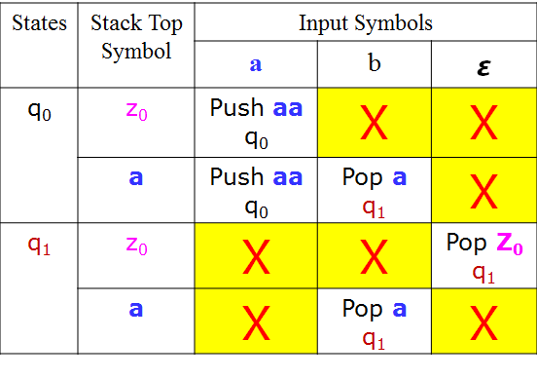
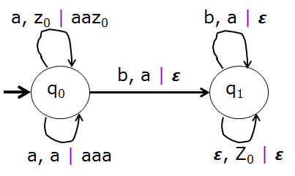
Construct PDA ( or DPDA) to recognize the language L={a^{n}b^{2n}, n>=1} by empty stack method.
Formal definition of PDA
P=(Q, ∑ , Γ , q₀, Z₀, δ, F)
Q = { q₀ , q₁ }
∑ = {a, b}
Γ ={a, Z₀}
q₀ = q₀
Z₀ = Z₀
F = { }
δ(q₀ , a, z₀) =(q₀ ,aaz₀)
δ(q₀ , a, a) =(q₀ ,aaa)
δ(q₀ , b, a) =(q₁ , 𝞮)
δ(q₁ , b, a) =(q₁ , 𝞮)
δ(q₁ , 𝞮, z₀) =(q₁ , 𝞮)
Push Operation
Pop Operation

Slide 24
Construct PDA ( or DPDA) to recognize the language L={a^{n}b^{2n}, n>=1} by empty stack method. Rough Slide
Instantaneous Description for the string "aabbbb"
(q₀, aabbbb, z₀)

Slide 25
Construct PDA ( or DPDA) to recognize the language L={a^{n}b^{2n}, n>=1} by empty stack method.
Instantaneous Description for the string "aabbbb"
(q₀, aabbbb, z₀) ˫ (q₀, abbbb, aaz₀)
˫ (q₀, bbbb, aaaaz₀)
˫ (q₁, bbb, aaaz₀)
˫ (q₁, bb, aaz₀)
˫ (q₁, b, az₀)
˫ (q₁, 𝞮, z₀)
˫ (q₁, 𝞮, 𝞮)
All the Input symbols
are read and Stack is
empty, therefore the string
“aabbbb” is accepted.

Slide 26
Construct PDA ( or DPDA) to recognize the language L={a^{n}b^{2n}, n>=1} by empty stack method.
Instantaneous Description for the string "aabbb"
(q₀, aabbb, z₀) ˫ (q₀, abbb, aaz₀)
˫ (q₀, bbb, aaaaz₀)
˫ (q₁, bb, aaaz₀)
˫ (q₁, b, aaz₀)
˫ (q₁, 𝞮, az₀)
All the Input symbols
are read but Stack not is
empty, therefore the string
“aabbb” is not accepted.

Slide 27
Question
The push down automata indicate the acceptance of input string in terms of
a) Finial state
b) Empty stack
c) Both (a) and (b)
d) None of these
Notes:
The push down automata indicate the acceptance of input string in terms of
a) Finial state
b) Empty store
c) Both (a) and (b)
d) None of these

Slide 28
Question
The push down automata indicate the acceptance of input string in terms of
a) Finial state
b) Empty stack
c) Both (a) and (b)
d) None of these
Notes:
The push down automata indicate the acceptance of input string in terms of
a) Finial state
b) Empty store
c) Both (a) and (b)
d) None of these

Slide 29
Question
The instantaneous description is PDA shows
a) Present state
b) Stack symbol
c) String to be processed
d) All of these
Notes:
The instantaneous description is PDA shows
a) Present state
b) Stack symbol
c) String to be processed
d) All of these

Slide 30
Question
The instantaneous description is PDA shows
a) Present state
b) Stack symbol
c) String to be processed
d) All of these
Notes:
The instantaneous description is PDA shows
a) Present state
b) Stack symbol
c) String to be processed
d) All of these

Slide 31
Question
Construct PDA ( or DPDA) to recognize the language L={a^{2n}b^{n}, n>=1} by empty stack method. Give the graphical representation of the PDA obtained. Show the moves made by PDA for the string aaaabb and aabbb

Slide 32
Question
Construct PDA ( or DPDA) to recognize the language L={a^{2n}b^{n}, n>=1} by empty stack method. Give the graphical representation of the PDA obtained. Show the moves made by PDA for the string aaaabb and aabbb
Solution:
Logic
Initial
State q₀
a | a | a | a | b | b | 𝞮
Go To
State q₁
Push a
Go To
State q₀
Go To
State q₁
Push a
Go To
State q₀
Pop a
Go To
State q₂
Pop a
Be in
State q₂
Pop Z₀
Be in
State q₂

Slide 33
Construct PDA ( or DPDA) to recognize the language L={a^{2n}b^{n}, n>=1} by empty stack method. Rough Slide
States | Stack Top Symbol | Input Symbols
 |  | a | b | 𝞮
q₀ | z₀
 | a
q₁ | z₀
 | a
q₂ | z₀
 | a

Slide 34
Construct PDA ( or DPDA) to recognize the language L={a^{2n}b^{n}, n>=1} by empty stack method.
States | Stack Top Symbol | Input Symbols
 |  | a | b | 𝞮
q₀ | z₀ | q₁ | X | X
 | a | q₁ | Pop a q₂ | X
q₁ | z₀ | Push a q₀ | X | X
 | a | Push a q₀ | X | X
q₂ | z₀ | X | X | Pop Z₀ q₂
 | a | X | Pop a q₂ | X

Slide 35
Construct PDA ( or DPDA) to recognize the language L={a^{2n}b^{n}, n>=1} by empty stack method.
Representing PDA as a generalized Transition Diagram
b, a | 𝞮
b, a | 𝞮
q₀
a, z₀ | z₀
a, a | a
q₁
q₂
a, z₀ | az₀
a, a | aa
𝞮, Z₀ | 𝞮

Slide 36
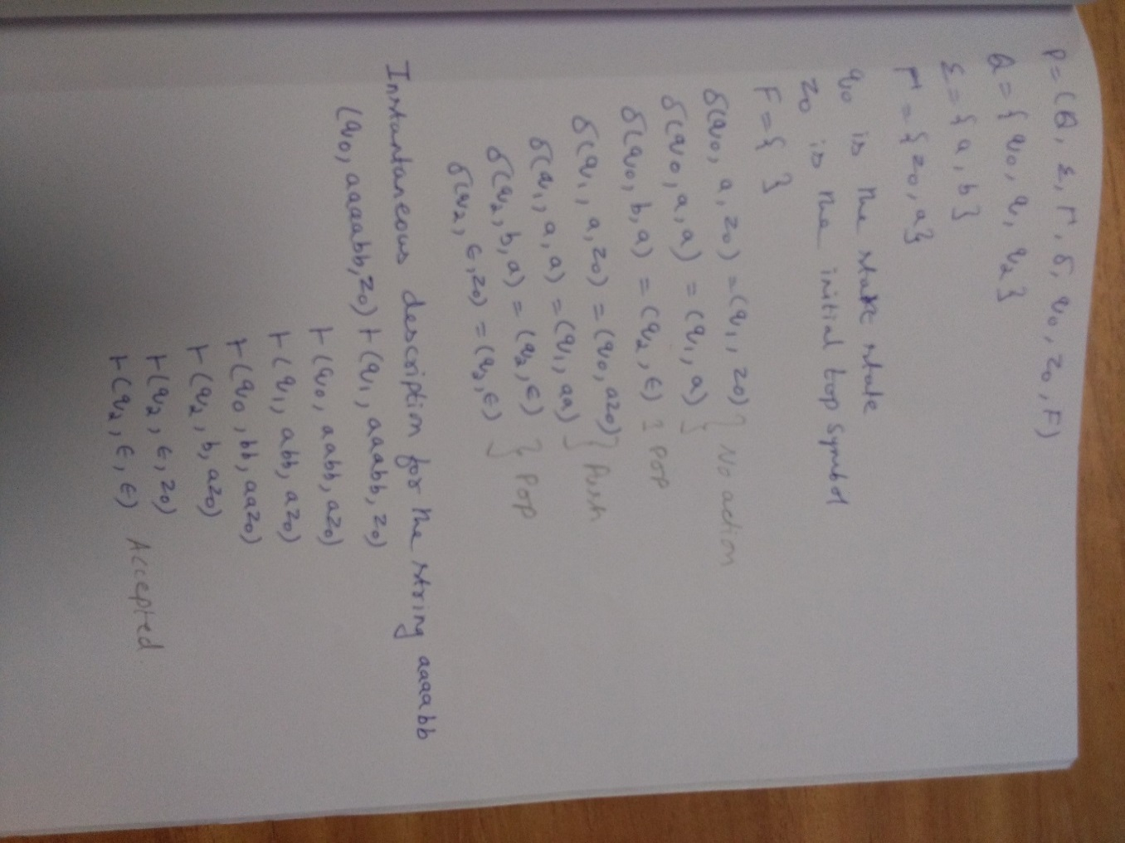
Construct PDA ( or DPDA) to recognize the language L={a^{2n}b^{n}, n>=1} by empty stack method.

Slide 37
Question
Design Deterministic Push Down Automata for the language L={WcW^{R}, W ∈ (a+b)*} by empty stack. Show instantaneous description for the string aabcbaa
Example Strings:
c , aca , bcb , aacaa , abcba , abbcbba
Logic: Push w on to stack, when c is seen switch to different state, for w^{r} do the Popping operation

Slide 38
Design DPDA for the language L={WcW^{R}, W ∈ (a+b)*} by empty stack. Rough Slide
State | Stack Top Symbol | Input Symbols
 |  | a | b | c | 𝞮
q₀ | z₀
 | a
 | b
q₁ | Z₀
 | a
 | b

Slide 39
Design DPDA for the language L={WcW^{R}, W ∈ (a+b)*} by empty stack.
State | Stack Top Symbol | Input Symbols
 |  | a | b | c | 𝞮
q₀ | z₀ | Push a q₀ | Push b q₀ | q₁ | X
 | a | Push a q₀ | Push b q₀ | q₁ | X
 | b | Push a q₀ | Push b q₀ | q₁ | X
q₁ | Z₀ | X | X | X | Pop Z₀ q₁
 | a | Pop a q₁ | X | X | X
 | b | X | Pop b q₁ | X | X
Transition Diagram
c, z₀ | z₀
c, a | a
c, b | b
q₀
q₁
a, z₀ | az₀
b, z₀ | bz₀
a, a | aa
a, b | ab
b, b | bb
b, a | ba
a, a | 𝞮
b, b | 𝞮
𝞮, Z₀ | 𝞮

Slide 40
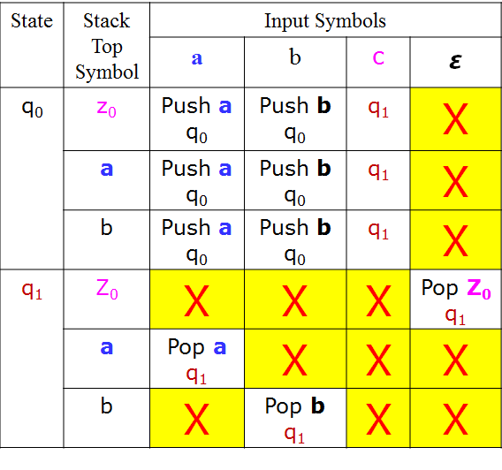
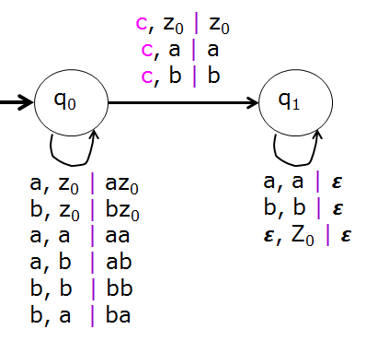
Design DPDA for the language L={WcW^{R}, W ∈ (a+b)*} by empty stack.
Formal definition of PDA
P=(Q, ∑ , Γ , q₀, Z₀, δ, F)
Q = { q₀ , q₁ }
∑ = {a, b, c}
Γ ={a, b, Z₀}
q₀ = q₀
Z₀ = Z₀
F = { }
δ(q₀ , a, z₀) =(q₀ ,az₀)
δ(q₀ , b, z₀) =(q₀ ,bz₀)
δ(q₀ , a, a) =(q₀ ,aa)
δ(q₀ , a, b) =(q₀ ,ab)
δ(q₀ , b, b) =(q₀ ,bb)
δ(q₀ , b, a) =(q₀ ,ba)
δ(q₀ , c, z₀) =(q₁ ,z₀)
δ(q₀ , c, a) =(q₁ ,a)
δ(q₀ , c, b) =(q₁ ,b)
δ(q₁ , a, a) =(q₁ , 𝞮)
δ(q₁ , b, b) =(q₁ , 𝞮)
δ(q₁ , 𝞮, z₀) =(q₁ , 𝞮)
Push Operation
No action
Pop Operation

Slide 41
Design DPDA for the language L={WcW^{R}, W ∈ (a+b)*} by empty stack. Rough Slide
Instantaneous Description for the string "aabcbaa"
(q₀, aabcbaa, z₀)

Slide 42
Design DPDA for the language L={WcW^{R}, W ∈ (a+b)*} by empty stack.
Instantaneous Description for the string "aabcbaa"
(q₀, aabcbaa, z₀) ˫ (q₀, abcbaa, az₀)
˫ (q₀, bcbaa, aaz₀)
˫ (q₀, cbaa, baaz₀)
˫ (q₁, baa, baaz₀)
˫ (q₁, aa, aaz₀)
˫ (q₁, a, az₀)
˫ (q₁, 𝞮, z₀)
˫ (q₁, 𝞮, 𝞮)
All the Input symbols
are read and Stack is
empty, therefore the string
“aabcbaa” is accepted.

Slide 43
Question
Design Deterministic Push Down Automata for the language L={W, W ∈ (a+b)* and n_{a}(w)==n_{b}(w)} by empty stack. Show instantaneous description for the string aababb
Example Strings:
ab , ba , baba , aabb , baab , aababb
Logic:
Input | Stack Top | Operation
a | Z₀ | Push a
b | Z₀ | Push b
a | a | Push a
b | a | Pop a
a | b | Pop b
b | b | Push b

Slide 44
Design DPDA for the language L={W, W ∈ (a+b)* and n_{a}(w)==n_{b}(w)} by empty stack. Rough Slide
State | Stack Top Symbol | Input Symbols
 |  | a | b | 𝞮
q₀ | z₀
 | a
 | b
q₁ | Z₀
 | a
 | b

Slide 45
Design DPDA for the language L={W, W ∈ (a+b)* and n_{a}(w)==n_{b}(w)} by empty stack.
State | Stack Top Symbol | Input Symbols
 |  | a | b | 𝞮
q₀ | z₀ | Push a q₀ | Push b q₀ | q₁
 | a | Push a q₀ | Pop a q₀ | X
 | b | Pop b q₀ | Push b q₀ | X
q₁ | Z₀ | X | X | Pop Z₀ q₁
 | a | X | X | X
 | b | X | X | X

Slide 46
Design DPDA for the language L={W, W ∈ (a+b)* and n_{a}(w)==n_{b}(w)} by empty stack.
Instantaneous Description for the string "aababb"
(q₀, aababb, z₀) ˫ (q₀, ababb, az₀)
˫ (q₀, babb, aaz₀)
˫ (q₀, abb, az₀)
˫ (q₀, bb, aaz₀)
˫ (q₀, b, az₀)
˫ (q₀, 𝞮, z₀)
˫ (q₁, 𝞮, z₀)
˫ (q₁, 𝞮, 𝞮)
All the Input symbols
are read and Stack is
empty, therefore the string
“aababb” is accepted.

Slide 47
Question
Design Deterministic Push Down Automata for the language L={W, W ∈ (a+b)* and n_{a}(w) < n_{b}(w)} by final state. Show instantaneous description for the string abbab
Example Strings:
b , bb , babab , abbb , bbbaa , abbab
Logic:
Input | Stack Top | Operation
a | Z₀ | Push a
b | Z₀ | Push b
a | a | Push a
b | a | Pop a
a | b | Pop b
b | b | Push b
𝞮 | b | Move to Final State

Slide 48
Design Deterministic Push Down Automata for the language L={W, W ∈ (a+b)* and n_{a}(w) < n_{b}(w)} by final state.
State | Stack Top Symbol | Input Symbols
 |  | a | b | 𝞮
q₀ | z₀ | Push a q₀ | Push b q₀ | X
 | a | Push a q₀ | Pop a q₀ | X
 | b | Pop b q₀ | Push b q₀ | q₁
q₁ | Z₀ | X | X | X
 | a | X | X | X
 | b | X | X | q₁
Transition Diagram
𝞮, b | b
q₀
q₁
a, z₀ | az₀
b, z₀ | bz₀
a, a | aa
a, b | 𝞮
b, b | bb
b, a | 𝞮
𝞮, b | b

Slide 49
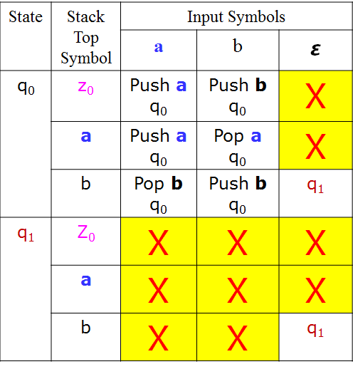
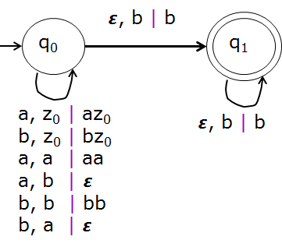
Design Deterministic Push Down Automata for the language L={W, W ∈ (a+b)* and n_{a}(w) < n_{b}(w)} by final state.
Formal definition of PDA
P=(Q, ∑ , Γ , q₀, Z₀, δ, F)
Q = { q₀ , q₁ }
∑ = {a, b}
Γ ={a, b, Z₀}
q₀ = q₀
Z₀ = Z₀
F = {q₁}
δ(q₀ , a, z₀) =(q₀ ,az₀)
δ(q₀ , b, z₀) =(q₀ ,bz₀)
δ(q₀ , a, a) =(q₀ ,aa)
δ(q₀ , b, b) =(q₀ ,bb)
δ(q₀ , a, b) =(q₀ , 𝞮)
δ(q₀ , b, a) =(q₀ , 𝞮)
δ(q₀ , 𝞮, b) =(q₁ ,b)
δ(q₁ , 𝞮, b) =(q₁ ,b)
Push Operation
Pop Operation
No action
Note: for n_{a}(w) > n_{b}(w)
δ(q₀ , 𝞮, a) =(q₁ ,a)
δ(q₁ , 𝞮, a) =(q₁ ,a)

Slide 50
Design Deterministic Push Down Automata for the language L={W, W ∈ (a+b)* and n_{a}(w) < n_{b}(w)} by final state.
Instantaneous Description for the string "abbab"
(q₀, abbab, z₀) ˫ (q₀, bbab, az₀)
˫ (q₀, bab, z₀)
˫ (q₀, ab, bz₀)
˫ (q₀, b, z₀)
˫ (q₀, 𝞮, bz₀)
˫ (q₁, 𝞮, bz₀)
˫ (q₁, 𝞮, bz₀)
All the Input symbols
are read and reached to
Final state, therefore the string
“abbab” is accepted.

Slide 51
Question
Design Deterministic Push Down Automata for the language L={a^{i}b^{J}c^{k} , J=i+k ,i,k≥0} by empty stack. Show instantaneous description for the string abbbcc
Example Strings:
i | k | J=i+k | Strings a^{i}b^{J}c^{k}
0 | 0 | 0 | 𝞮
1 | 1 | 2 | abbc
1 | 0 | 1 | ab
0 | 1 | 1 | bc
2 | 2 | 4 | aabbbbcc
2 | 1 | 3 | aabbbc
1 | 2 | 3 | abbbcc

Slide 52
Question
Design Deterministic Push Down Automata for the language L={a^{i}b^{J}c^{k} , J=i+k ,i,k≥0} by empty stack. Show instantaneous description for the string abbbcc
Example Strings:
𝞮 , abbc , ab , bc , aabbbbcc , aabbbc , abbbcc
Logic:
a^{i}b^{J}c^{k}
a^{i}b^{i}b^{k}c^{k}
a^{i} | b^{i} | b^{k} | c^{k} | 𝞮
Push a
Pop a
Push b
Pop b
Pop Z₀

Slide 53
Design Deterministic Push Down Automata for the language L={a^{i}b^{J}c^{k} , J=i+k ,i,k≥0} by empty stack. Rough Slide
State | Stack Top Symbol | Input Symbols
 |  | a | b | c | 𝞮
q₀ | z₀
 | a
 | b
q₁ | Z₀
 | a
 | b
q2 | Z₀
 | a
 | b
q3 | Z₀
 | a
 | b

Slide 54
Design Deterministic Push Down Automata for the language L={a^{i}b^{J}c^{k} , J=i+k ,i,k≥0} by empty stack.
State | Stack Top Symbol | Input Symbols
 |  | a | b | c | 𝞮
q₀ | z₀ | Push a , q₀ | Push b, q₁ | X | q₃
 | a | Push a , q₀ | Pop a, q₁ | X | X
 | b | X | X | X | X
q₁ | Z₀ | X | Push b, q₁ | X | X
 | a | X | Pop a, q₁ | X | X
 | b | X | Push b, q₁ | Pop b, q₂ | X
q2 | Z₀ | X | X | X | q₃
 | a | X | X | X | X
 | b | X | X | Pop b, q₂ | X
q3 | Z₀ | X | X | X | Pop z₀, q3
 | a | X | X | X | X
 | b | X | X | X | X

Slide 55
Design Deterministic Push Down Automata for the language L={a^{i}b^{J}c^{k} , J=i+k ,i,k≥0} by empty stack.
Instantaneous Description for the string "abbbcc"
(q₀, abbbcc, z₀) ˫ (q₀, bbbcc, az₀)
˫ (q₀, bbcc, z₀)
˫ (q₁, bcc, bz₀)
˫ (q₁, cc, bbz₀)
˫ (q₂, c, bz₀)
˫ (q₂, 𝞮, z₀)
˫ (q₃, 𝞮, z₀)
˫ (q₃, 𝞮, 𝞮)
All the Input symbols
are read and stack is
empty, therefore the string
“abbbcc” is accepted.

Slide 56
Question
Construct PDA ( or DPDA) to recognize the language L={a^{n}b^{n}, n>=1} by final state method.

Slide 57
Construct PDA ( or DPDA) to recognize the language L={a^{n}b^{n}, n>=1} by final state method. Rough Slide
States | Stack Top Symbol | Input Symbols
 |  | a | b | 𝞮
q₀ | z₀
 | a
q₁ | z₀
 | a
q₂ | z₀
 | a

Slide 58
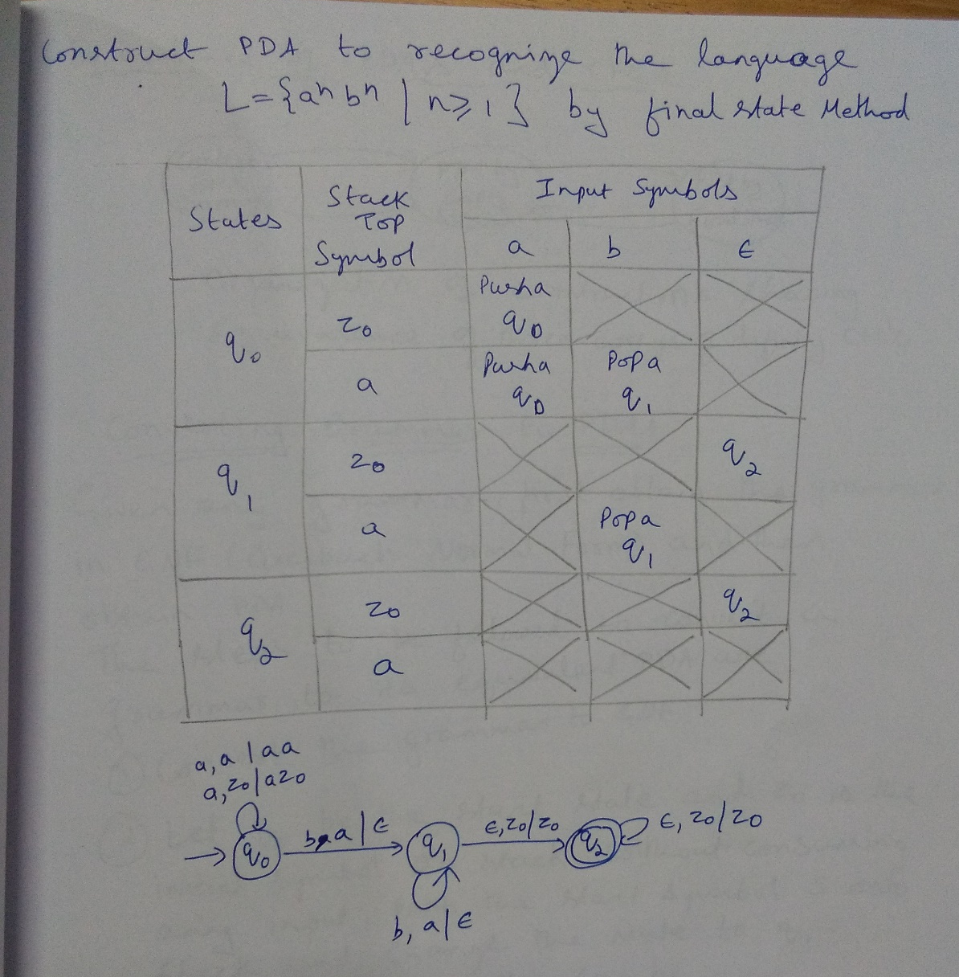

Slide 59
Question
Design Non-deterministic Push Down Automata for the language L={WW^{R}, W ∈ (a+b)*} by empty stack. Show instantaneous description for the string abba
or
Design Non-deterministic Push Down Automata for the language L={x, x ∈ (a+b)* and x is a palindrome} by empty stack. Show instantaneous description for the string abba

Slide 60
Question
Design Non-deterministic Push Down Automata for the language L={WW^{R}, W ∈ (a+b)*} by empty stack. Show instantaneous description for the string abba
Example Strings:
𝞮 , aa , bb , aaaa , abaaba , bbaabb , abbbba

Slide 61
Question
Design Non-deterministic Push Down Automata for the language L={WW^{R}, W ∈ (a+b)*} by empty stack. Show instantaneous description for the string abba
Example Strings:
𝞮 , aa , bb , aaaa , abaaba , bbaabb
Logic:
Input | Stack Top | Operation
a | Z₀ | Push a, q₀
b | Z₀ | Push b, q₀
a | a | Push a, q₀ ; Pop a , q₁
b | a | Push b, q₀
a | b | Push a, q₀
b | b | Push b, q₀ ; Pop b, q₁

Slide 62
Design NPDA for the language L={WW^{R}, W ∈ (a+b)*} by empty stack. Rough Slide
Logic
Instantaneous Description for the string "abba"
Input | Stack Top | Operation
a | Z₀ | Push a, q₀
b | Z₀ | Push b, q₀
a | a | Push a, q₀ ; Pop a , q₁
b | a | Push b, q₀
a | b | Push a, q₀
b | b | Push b, q₀ ; Pop b, q₁
𝞮 | Z₀ | Change state to q₂
𝞮 | Z₀ | Pop Z₀ , q₂
(q₀, abba, z₀)

Slide 63
Design NPDA for the language L={WW^{R}, W ∈ (a+b)*} by empty stack.
Logic
Instantaneous Description for the string "abba"
Input | Stack Top | Operation
a | Z₀ | Push a, q₀
b | Z₀ | Push b, q₀
a | a | Push a, q₀ ; Pop a , q₁
b | a | Push b, q₀
a | b | Push a, q₀
b | b | Push b, q₀ ; Pop b, q₁
(q₀, abba, z₀) ˫ (q₀, bba, az₀)
˫ (q₀, ba,baz₀)
(q₀, a, bbaz₀)
(q₁, a, az₀)
(q₀, 𝞮, abbaz₀)
(q₁, 𝞮, z₀)
(q₁, 𝞮, 𝞮)
Rejected
Accepted

Slide 64
Design NPDA for the language L={WW^{R}, W ∈ (a+b)*} by empty stack. Rough Slide
State | Stack Top Symbol | Input Symbols
 |  | a | b | 𝞮
q₀ | z₀
 | a
 | b
q₁ | Z₀
 | a
 | b
q₂ | Z₀
 | a
 | b

Slide 65
Design NPDA for the language L={WW^{R}, W ∈ (a+b)*} by empty stack.
State | Stack Top Symbol | Input Symbols
 |  | a | b | 𝞮
q₀ | z₀ | Push a , q₀ | Push b , q₀ | q₂
 | a | Push a , q₀ | Push b , q₀ | X
 |  | Pop a , q₁
 | b | Push a , q₀ | Push b , q₀ | X
 |  |  | Pop b , q₁
q₁ | Z₀ | X | X | q₂
 | a | Pop a , q₁ | X | X
 | b | X | Pop b , q1 | X
q₂ | Z₀ | X | X | Pop Z₀ , q₂
 | a | X | X | X
 | b | X | X | X

Slide 66
Design NPDA for the language L={WW^{R}, W ∈ (a+b)*} by empty stack.
Formal definition of PDA
P=(Q, ∑ , Γ , q₀, Z₀, δ, F)
Q = { q₀ , q₁ , q₂}
∑ = {a, b}
Γ ={a, b, Z₀}
q₀ = q₀
Z₀ = Z₀
F = { }
δ(q₀ , a, z₀) =(q₀ ,az₀)
δ(q₀ , b, z₀) =(q₀ ,bz₀)
δ(q₀ , a, b) ={(q₀ ,ab)
δ(q₀ , b, a) ={(q₀ ,ba)
δ(q₀ , a, a) ={(q₀ , aa), (q₁, 𝞮)}
δ(q₀ , b, b) ={(q₀ ,bb), (q₁, 𝞮)}
δ(q₁ , a, a) =(q₁ , 𝞮)
δ(q₁ , b, b) =(q₁ , 𝞮)
δ(q₁ , 𝞮, z₀) =(q₂ , Z₀)
δ(q₂ , 𝞮, z₀) =(q₂ , 𝞮)
Transition Diagram
a, a | 𝞮
b, b | 𝞮
𝞮, Z₀| z₀
q₀
q₁
q₂
a, z₀ | az₀
b, z₀ | bz₀
a, a | aa
a, b | ab
b, b | bb
b, a | ba
a, a | 𝞮
b, b | 𝞮
𝞮, Z₀| 𝞮

Slide 67
Equivalence of PDA and CFG
- Converting CFG to PDA
- Converting PDA to CFG

Slide 68
Procedure for converting PDA to CFG
1. The input symbols of PDA will be the terminals of CFG
2. If PDA moves from state q_{i} to q_{j} on consuming the input a ∈ Σ when Z is top of the stack, then the non-terminals of CFG are the triplets of the form (q_{i}Zq_{j})
3. If q₀ is the start state and q_{f} is the final state then (q₀Zq_{f}) is the start symbol of the CFG
4. The productions of CFG can be obtained from the transitions of PDA as shown below:
For each transition of the form δ(q_{i} , a, Z) = (q_{j}, AB) introduce the productions of the form
(q_{i}Zq_{k}) -> a(q_{j}Aq_{l})(q_{l}Bq_{k}) where q_{k} and q_{l} will take all possible values from Q
For each transition of the form δ(q_{i} , a, Z) = (q_{j}, ε ) introduce the production (q_{i}Zq_{j}) -> a
Note: Using this procedure, we may introduce lot of useless symbols, which in any way can be eliminated.

Slide 69
Question
Obtain CFG that generates the language accepted by the PDA
P=(Q, ∑ , Γ , q₀, Z₀, δ, F)
Q = { q₀ , q₁ }
∑ = {a, b}
Γ ={A, Z}
q₀ = q₀
Z₀ = Z
F = {q₁}
δ(q₀ , a, Z)=(q₀, AZ)
δ(q₀ , b, A)=(q₀, AA)
δ(q₀ , a, A)=(q₁, 𝞮)
a, A | 𝞮
q₀
q₁
a, z | AZ
b, A | AA

Slide 70
Question
Obtain CFG that generates the language accepted by the PDA M=({q₀ , q₁ }, {a, b}, {A, Z}, q₀ , Z , {q₁} ,
{ δ(q₀ , a, Z)=(q₀, AZ),
δ(q₀ , b, A)=(q₀, AA),
δ(q₀ , a, A)=(q₁, 𝞮))
Solution:
For δ of the form δ(q_{i} , a, Z) = (q_{j}, ε ) | Resulting Production (q_{i}Zq_{j}) → a
δ(q₀ , a, A)=(q₁, ε) | (q₀Aq₁) → a

Slide 71
Obtain CFG that generates the language accepted by the PDA M=({q₀ , q₁ }, {a, b}, {A, Z}, q₀ , Z , {q₁} , {δ(q₀ , a, Z)=(q₀, AZ), δ(q₀ , b, A)=(q₀, AA), δ(q₀ , a, A)=(q₁, 𝞮))
Solution (Contd…):
For δ of the form δ(q_{i} , a, Z) = (q_{j}, AB) | Resulting Production (q_{i}Zq_{k}) → a(q_{j}Aq_{l})(q_{l}Bq_{k}) where q_{k} and q_{l} will take all possible values from Q
δ(q₀ , a, Z)=(q₀, AZ)

Slide 72
Obtain CFG that generates the language accepted by the PDA M=({q₀ , q₁ }, {a, b}, {A, Z}, q₀ , Z , {q₁} , {δ(q₀ , a, Z)=(q₀, AZ), δ(q₀ , b, A)=(q₀, AA), δ(q₀ , a, A)=(q₁, 𝞮))
Solution (Contd…):
For δ of the form δ(q_{i} , a, Z) = (q_{j}, AB) | Resulting Production (q_{i}Zq_{k}) → a(q_{j}Aq_{l})(q_{l}Bq_{k}) where q_{k} and q_{l} will take all possible values from Q
δ(q₀ , a, Z)=(q₀, AZ) | (q₀Zq₀) → a(q₀Aq₀)(q₀Zq₀) | a(q₀Aq₁)(q₁Zq₀) (q₀Zq₁) → a(q₀Aq₀)(q₀Zq₁) | a(q₀Aq₁)(q₁Zq₁)

Slide 73
Obtain CFG that generates the language accepted by the PDA M=({q₀ , q₁ }, {a, b}, {A, Z}, q₀ , Z , {q₁} , {δ(q₀ , a, Z)=(q₀, AZ), δ(q₀ , b, A)=(q₀, AA), δ(q₀ , a, A)=(q₁, 𝞮))
Solution (Contd…):
For δ of the form δ(q_{i} , a, Z) = (q_{j}, AB) | Resulting Production (q_{i}Zq_{k}) → a(q_{j}Aq_{l})(q_{l}Bq_{k}) where q_{k} and q_{l} will take all possible values from Q
δ(q₀ , a, Z)=(q₀, AZ) | (q₀Zq₀) → a(q₀Aq₀)(q₀Zq₀) | a(q₀Aq₁)(q₁Zq₀) (q₀Zq₁) → a(q₀Aq₀)(q₀Zq₁) | a(q₀Aq₁)(q₁Zq₁)
δ(q₀ , b, A)=(q₀, AA) | (q₀Aq₀) → b(q₀Aq₀)(q₀Aq₀) | b(q₀Aq₁)(q₁Aq₀) (q₀Aq₁) → b(q₀Aq₀)(q₀Aq₁) | b(q₀Aq₁)(q₁Aq₁)
Start Symbol of the grammar is (q₀Zq₁)

Slide 74
Obtain CFG that generates the language accepted by the PDA M=({q₀ , q₁ }, {a, b}, {A, Z}, q₀ , Z , {q₁} , {δ(q₀ , a, Z)=(q₀, AZ), δ(q₀ , b, A)=(q₀, AA), δ(q₀ , a, A)=(q₁, 𝞮))
Solution (Contd…):
G=(V, T, P, S)
V= {(q₀Zq₁) , (q₀Aq₁) , (q₀Zq₀), (q₀Aq₀) ,
(q₁Zq₀) , (q₁Zq₁) , (q₁Aq₀) , (q₁Aq₁) }
T={a, b}
P={
(q₀Aq₁) → a
(q₀Zq₀) → a(q₀Aq₀)(q₀Zq₀) | a(q₀Aq₁)(q₁Zq₀)
(q₀Zq₁) → a(q₀Aq₀)(q₀Zq₁) | a(q₀Aq₁)(q₁Zq₁)
(q₀Aq₀) → b(q₀Aq₀)(q₀Aq₀) | b(q₀Aq₁)(q₁Aq₀)
(q₀Aq₁) → b(q₀Aq₀)(q₀Aq₁) | b(q₀Aq₁)(q₁Aq₁)
}
S=(q₀Zq₁)

Slide 75
Question
Obtain CFG that generates the language accepted by the PDA
P=(Q, ∑ , Γ , q₀, Z₀, δ, F)
Q = { q₀ , q_{1 ,} q₂ }
∑ = {a, b}
Γ ={A, Z}
q₀ = q₀
Z₀ = Z
F = {q₂}
δ(q₀ , a, Z)=(q₀, AZ)
δ(q₀ , a, A)=(q₀, A)
δ(q₀ , b, A)=(q₁, 𝞮)
δ(q₁ , 𝞮, Z)=(q₂, 𝞮)

Slide 76
Converting PDA to CFG: M=({ q₀ , q_{1 ,} q₂ }, {a, b} , {A, Z}, q_{0 ,} Z, {q₂}, { δ(q₀ , a, Z)=(q₀, AZ), δ(q₀ , a, A)=(q₀, A), δ(q₀ , b, A)=(q₁, 𝞮), δ(q₀ , 𝞮, Z)=(q₂, 𝞮)}
Solution:
To obtain CFG from the PDA, all transitions should be of the form
δ(q_{i} , a, Z) = (q_{j}, AB)
or
δ(q_{i} , a, Z) = (q_{j}, ε )
In the given transitions except the second transition, all transitions are in the required form. So, let us take the second transition
δ(q₀ , a, A)=(q₀, A)
This transition indicates that when input symbol a is encountered and top stack symbol is A, the PDA remains in the state q₀ and contents of the stack are not altered. This can be interpreted as delete A from stack and insert A onto the stack. So once A is deleted from the stack we enter into a new state q₃. But in state q₃ without consuming any input we add A onto the stack. The corresponding transitions are
δ(q₀ , a, A)=(q₃, 𝞮)
δ(q₃ , 𝞮, Z)=(q₀, AZ)

Slide 77
Converting PDA to CFG: M=({ q₀ , q_{1 ,} q₂ }, {a, b} , {A, Z}, q_{0 ,} Z, {q₂}, { δ(q₀ , a, Z)=(q₀, AZ), δ(q₀ , a, A)=(q₀, A), δ(q₀ , b, A)=(q₁, 𝞮), δ(q₁ , 𝞮, Z)=(q₂, 𝞮)}
Solution (Contd…):
So the given PDA can be written using the following transitions
δ(q₀ , a, Z)=(q₀, AZ)
δ(q₀ , a, A)=(q₃, 𝞮)
δ(q₃ , 𝞮, Z)=(q₀, AZ)
δ(q₀ , b, A)=(q₁, 𝞮)
δ(q₁ , 𝞮, Z)=(q₂, 𝞮)
For δ of the form δ(q_{i} , a, Z) = (q_{j}, ε ) | Resulting Production (q_{i}Zq_{j}) → a
δ(q₀ , a, A)=(q₃, 𝞮) | (q₀Aq₃)→ a
δ(q₀ , b, A)=(q₁, 𝞮) | (q₀Aq₁) → b
δ(q₁ , 𝞮, Z)=(q₂, 𝞮) | (q₁Zq₂) → 𝞮

Slide 78
Converting PDA to CFG: M=({ q₀ , q_{1 ,} q₂ }, {a, b} , {A, Z}, q_{0 ,} Z, {q₂}, { δ(q₀ , a, Z)=(q₀, AZ), δ(q₀ , a, A)=(q₀, A), δ(q₀ , b, A)=(q₁, 𝞮), δ(q₁ , 𝞮, Z)=(q₂, 𝞮)}
Solution (Contd…):
So the given PDA can be written using the following transitions
δ(q₀ , a, Z)=(q₀, AZ) , δ(q₀ , a, A)=(q₃, 𝞮), δ(q₃ , 𝞮, Z)=(q₀, AZ)
δ(q₀ , b, A)=(q₁, 𝞮) , δ(q₁ , 𝞮, Z)=(q₂, 𝞮)
For δ of the form δ(q_{i} , a, Z) = (q_{j}, AB) | Resulting Production (q_{i}Zq_{k}) → a(q_{j}Aq_{l})(q_{l}Bq_{k}) where q_{k} and q_{l} will take all possible values from Q
δ(q₀ , a, Z)=(q₀, AZ) | (q₀Zq₀) → a(q₀Aq₀)(q₀Zq₀) | a(q₀Aq₁)(q₁Zq₀) | a(q₀Aq₂)(q₂Zq₀) | a(q₀Aq₃)(q₃Zq₀) (q₀Zq₁) → a(q₀Aq₀)(q₀Zq₁) | a(q₀Aq₁)(q₁Zq₁) | a(q₀Aq₂)(q₂Zq₁) | a(q₀Aq₃)(q₃Zq₁) (q₀Zq₂) → a(q₀Aq₀)(q₀Zq₂) | a(q₀Aq₁)(q₁Zq₂) | a(q₀Aq₂)(q₂Zq₂) | a(q₀Aq₃)(q₃Zq₂) (q₀Zq₃) → a(q₀Aq₀)(q₀Zq₃) | a(q₀Aq₁)(q₁Zq₃) | a(q₀Aq₂)(q₂Zq₃) | a(q₀Aq₃)(q₃Zq₃)

Slide 79
Converting PDA to CFG: M=({ q₀ , q_{1 ,} q₂ }, {a, b} , {A, Z}, q_{0 ,} Z, {q₂}, { δ(q₀ , a, Z)=(q₀, AZ), δ(q₀ , a, A)=(q₀, A), δ(q₀ , b, A)=(q₁, 𝞮), δ(q₁ , 𝞮, Z)=(q₂, 𝞮)}
Solution (Contd…):
So the given PDA can be written using the following transitions
δ(q₀ , a, Z)=(q₀, AZ) , δ(q₀ , a, A)=(q₃, 𝞮), δ(q₃ , 𝞮, Z)=(q₀, AZ)
δ(q₀ , b, A)=(q₁, 𝞮) , δ(q₁ , 𝞮, Z)=(q₂, 𝞮)
For δ of the form δ(q_{i} , a, Z) = (q_{j}, AB) | Resulting Production (q_{i}Zq_{k}) → a(q_{j}Aq_{l})(q_{l}Bq_{k}) where q_{k} and q_{l} will take all possible values from Q
δ(q₃ , 𝞮, Z)=(q₀, AZ) | (q₃Zq₀) → (q₀Aq₀)(q₀Zq₀) | (q₀Aq₁)(q₁Zq₀) | (q₀Aq₂)(q₂Zq₀) | (q₀Aq₃)(q₃Zq₀) (q₃Zq₁) → (q₀Aq₀)(q₀Zq₁) | (q₀Aq₁)(q₁Zq₁) | (q₀Aq₂)(q₂Zq₁) | (q₀Aq₃)(q₃Zq₁) (q₃Zq₂) → (q₀Aq₀)(q₀Zq₂) | (q₀Aq₁)(q₁Zq₂) | (q₀Aq₂)(q₂Zq₂) | (q₀Aq₃)(q₃Zq₂) (q₃Zq₃) → (q₀Aq₀)(q₀Zq₃) | (q₀Aq₁)(q₁Zq₃) | (q₀Aq₂)(q₂Zq₃) | (q₀Aq₃)(q₃Zq₃)
Start Symbol of the grammar is (q₀Zq₂)

Slide 80
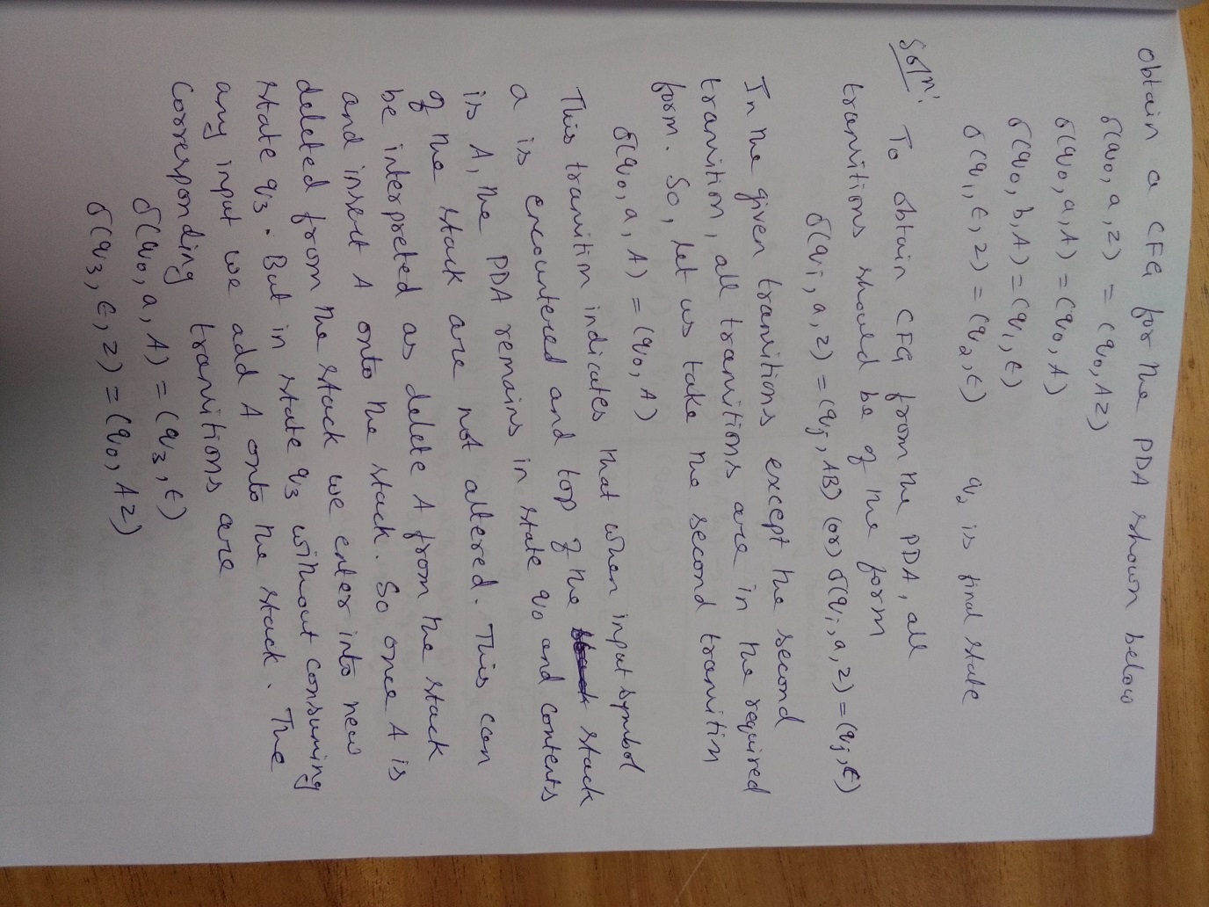

Slide 81
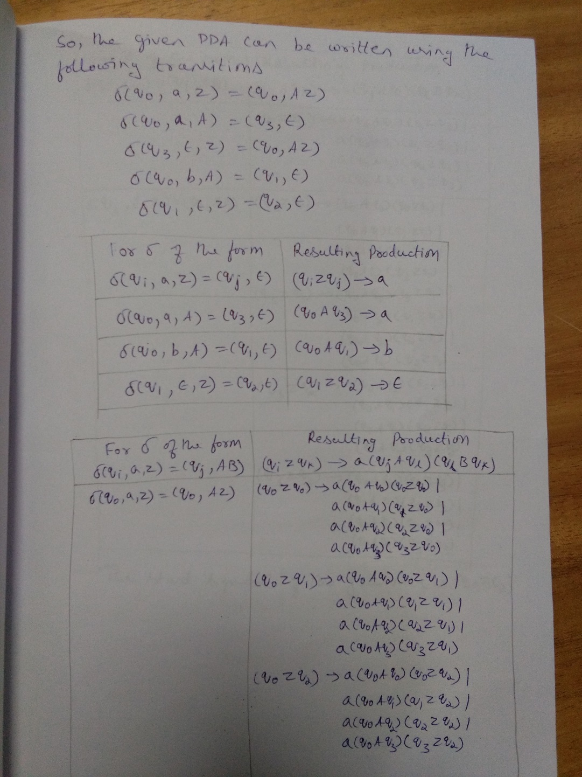

Slide 82
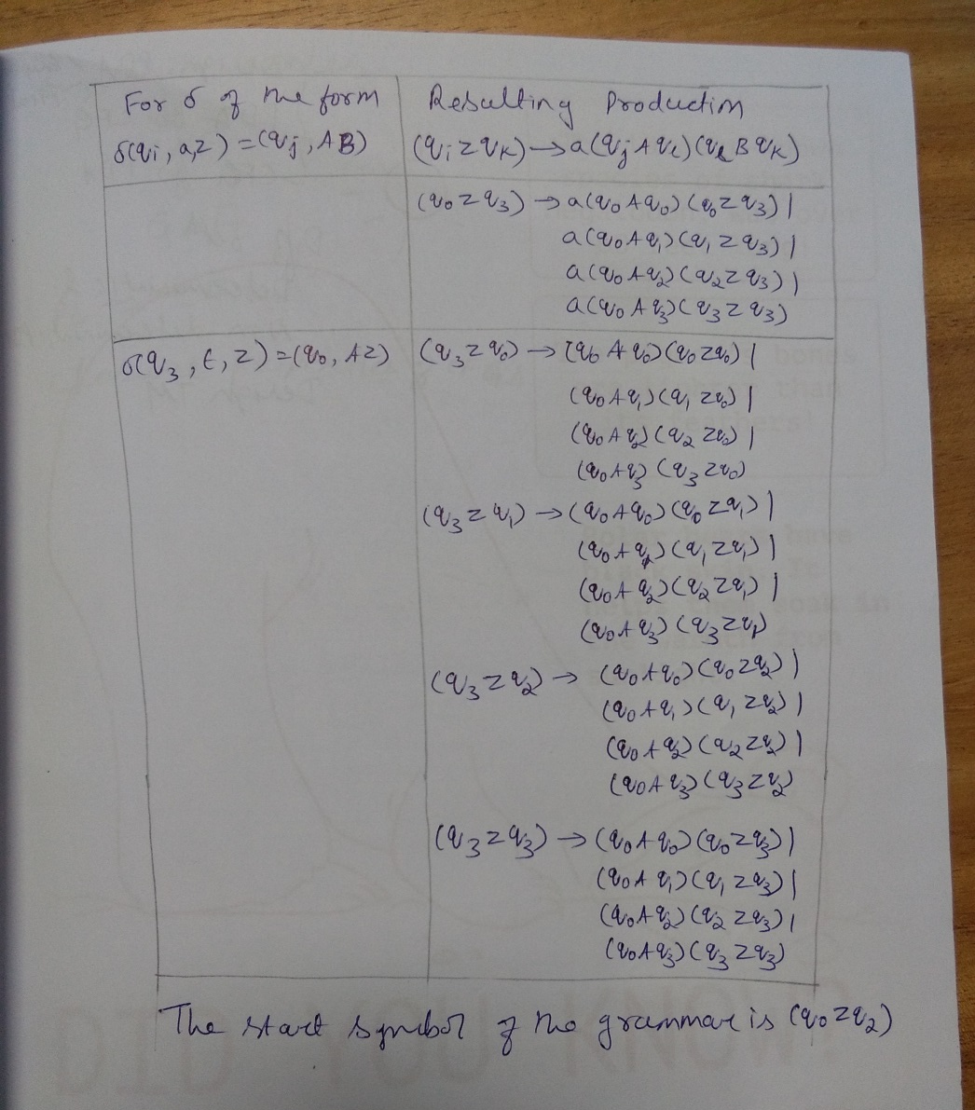

Slide 83
Greibach Normal Form (GNF)
In Greibach Normal Form (GNF), there is a restriction on the terminals and variables appearing on the right hand side of the production.
A CFG G = (V, T, P, S) is said to be in GNF if every production is of the form
A → a⍺
where a ∈ T and ⍺ ∈ V ∗ , i.e., ⍺ is a string of zero or more variables.
The first symbol on the right hand side of the production must be a terminal and it can be followed by zero or more Variables.
If Grammar is in GNF, it can be easily converted into Push Down Automata (PDA), which accepts Context Free Languages

Slide 84
Procedure for converting CFG to PDA
Given any grammar, first obtain the grammar in GNF (Greibach Normal Form) and then obtain PDA.
The steps to be followed to convert a grammar G=(V,T,P,S) to its equivalent PDA are
1. Convert the grammar to GNF
2. Let q₀ be the start state and z₀ is initial symbol on stack. Without consuming any input, push the start symbol S onto the stack and change state to q₁
The transition for this can be δ(q₀, ε, z₀)=(q₁,Sz₀)
3. For each production of the form A -> aβ introduce the transition
δ(q₁ , a, A)=(q₁, β)
4. Finally, in state q₁ , without consuming any input change the state to q_{f} which is an accepting state. The transition can be of the form δ(q₁ , ε, z₀)=(q_{f}, z₀)

Slide 85
Question
Convert following Grammar to PDA. Show the instantaneous description for the string “aabba”
S → aABC
A → aB | a
B → bA | b
C → a

Slide 86
Convert following Grammar to PDA. S → aABC ; A → aB | a ; B → bA | b ; C → a
Solution:
Step1: Convert the grammar to GNF
The given grammar is in GNF
Step2: Let q₀ be the start state and z₀ is initial symbol on stack. Without consuming any input, push the start symbol S onto the stack and change state to q₁
The transition for this can be δ(q₀, ε, z₀)=(q₁,Sz₀)

Slide 87
Convert following Grammar to PDA. S → aABC ; A → aB | a ; B → bA | b ; C → a Rough Slide
Solution (Contd…):
Step3: For each production of the form A -> aβ introduce the transition δ(q₁ , a, A)=(q₁, β)
Production | Transition
S → aABC
A → aB
A → a
B → bA
B → b
C → a

Slide 88
Convert following Grammar to PDA. S → aABC ; A → aB | a ; B → bA | b ; C → a
Solution (Contd…):
Step3: For each production of the form A -> aβ introduce the transition δ(q₁ , a, A)=(q₁, β)
Step4:Finally, in state q₁ , without consuming any input change the state to q_{f} which is an accepting state. The transition can be of the form δ(q₁ , ε, z₀)=(q_{f}, z₀)
Production | Transition
S → aABC | δ(q₁ , a, S)=(q₁, ABC)
A → aB | δ(q₁ , a, A)=(q₁, B)
A → a | δ(q₁ , a, A)=(q₁, 𝞮)
B → bA | δ(q₁ , b, B)=(q₁, A)
B → b | δ(q₁ , b, B)=(q₁, 𝞮)
C → a | δ(q₁ , a, C)=(q₁, 𝞮)

Slide 89
Convert following Grammar to PDA. S → aABC ; A → aB | a ; B → bA | b ; C → a
Formal definition of PDA
P=(Q, ∑ , Γ , q₀, Z₀, δ, F)
Q = { q₀ , q₁ , q_{f} }
∑ = {a, b}
Γ ={S, A, B, C, Z₀}
q₀ = q₀
Z₀ = Z₀
F = {q_{f}}
δ(q₀, ε, z₀)=(q₁,Sz₀)
δ(q₁ , a, S)=(q₁, ABC)
δ(q₁ , a, A)=(q₁, B)
δ(q₁ , a, A)=(q₁, 𝞮)
δ(q₁ , b, B)=(q₁, A)
δ(q₁ , b, B)=(q₁, 𝞮)
δ(q₁ , a, C)=(q₁, 𝞮)
δ(q₁ , ε, z₀)=(q_{f}, z₀)

Slide 90
Convert following Grammar to PDA. S → aABC ; A → aB | a ; B → bA | b ; C → a Rough Slide
Instantaneous Description for the string "aabba"
Transitions of PDA
δ(q₀, ε, z₀)=(q₁,Sz₀)
δ(q₁ , a, S)=(q₁, ABC)
δ(q₁ , a, A)=(q₁, B)
δ(q₁ , a, A)=(q₁, 𝞮)
δ(q₁ , b, B)=(q₁, A)
δ(q₁ , b, B)=(q₁, 𝞮)
δ(q₁ , a, C)=(q₁, 𝞮)
δ(q₁ , ε, z₀)=(q_{f}, z₀)

Slide 91
Convert following Grammar to PDA. S → aABC ; A → aB | a ; B → bA | b ; C → a
Instantaneous Description for the string "aabba"
(q₀, aabba, z₀) ˫ (q₁, aabba, Sz₀)
˫ (q₁, abba, ABCz₀)
Transitions of PDA
δ(q₀, ε, z₀)=(q₁,Sz₀)
δ(q₁ , a, S)=(q₁, ABC)
δ(q₁ , a, A)=(q₁, B)
δ(q₁ , a, A)=(q₁, 𝞮)
δ(q₁ , b, B)=(q₁, A)
δ(q₁ , b, B)=(q₁, 𝞮)
δ(q₁ , a, C)=(q₁, 𝞮)
δ(q₁ , ε, z₀)=(q_{f}, z₀)
(q₁, bba, BBCz₀)
(q₁, bba, BCz₀)
(q₁, ba, BCz₀)
(q₁, ba, ABCz₀)
(q₁, a, Cz₀)
(q₁, a, ACz₀)
(q₁, 𝞮, z₀)
(q_{f}, 𝞮, z₀)
Accepted
All Input Symbols are read and the final state is reached,
therefore the string “aabba” is accepted

Slide 92
Question
Convert following Grammar to PDA.
S → aABB | aAA
A → aBB | a
B → bBB | A
C → a

Slide 93
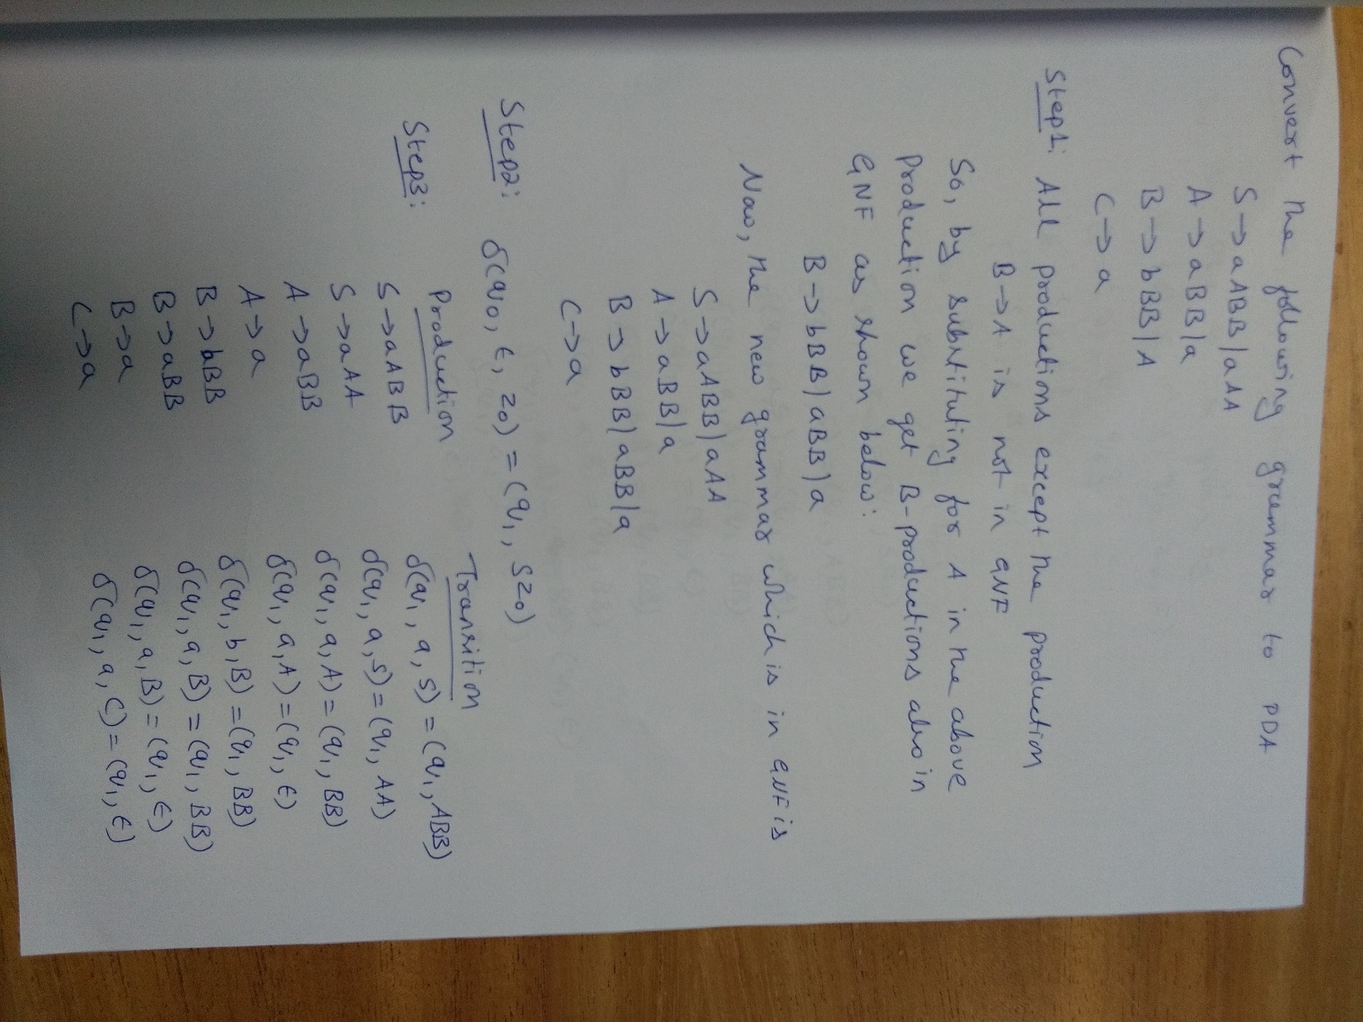

Slide 94
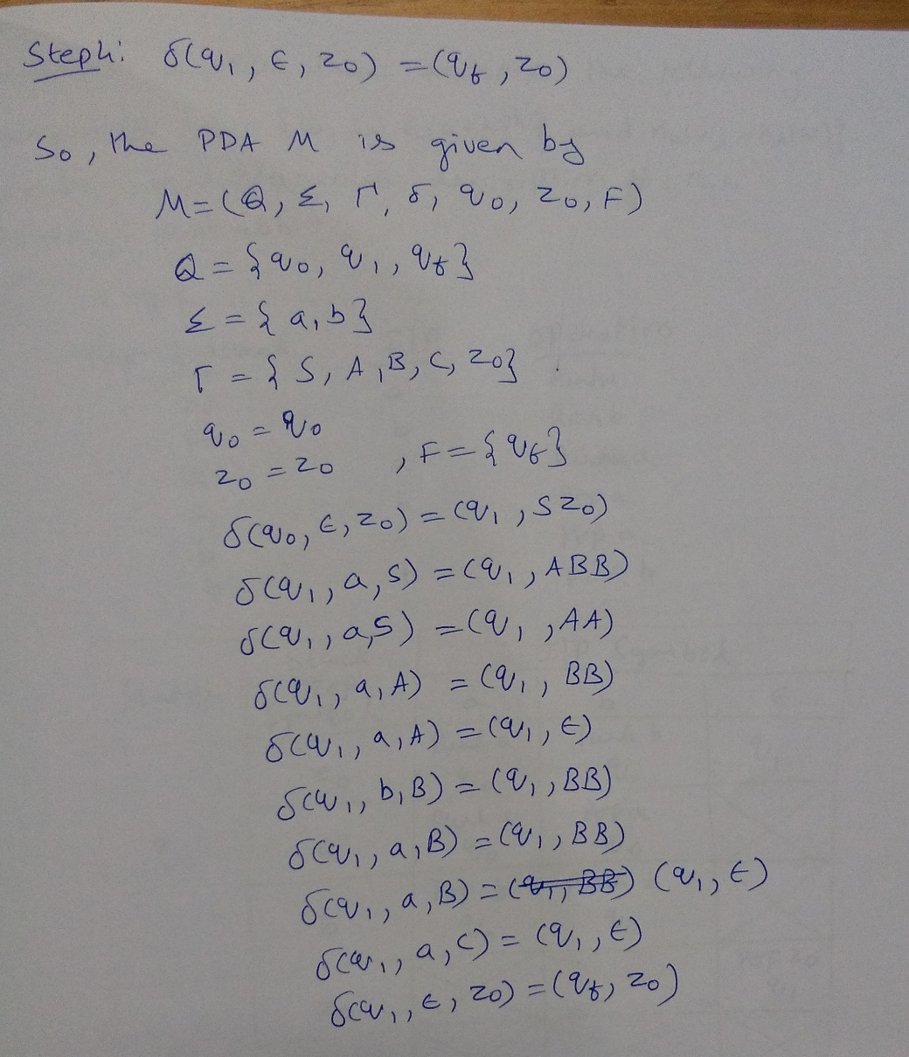

Slide 95
Pumping Lemma for CFL

Slide 96
Pumping Lemma for Context Free Language (CFL)
Let L be context free language and is infinite. Let z is sufficiently long string and z ∈ L ,
so that |z| >=n where n is some positive integer. If the string z can be decomposed into combination of strings
z=uvwxy
Such that |vwx| <= n , |vx| >=1 ,
then uv^{i}wx^{i}y ∈ L for i=0,1,2,3,……

Slide 97
Using Pumping Lemma to show certain languages are not CFL
The general strategy used to prove that a given language is not CFL is shown below:
1. Assume that the language L is infinite and it is context free
2. Select string say z and break it into sub strings u, v, w, x and y such that |z|>=n,
z=uvwxy where |vwx| <= n , |vx| >=1
3. Find any i such that uv^{i}wx^{i}y ∉ L . According to pumping lemma uv^{i}wx^{i}y ∈ L . So, the result is a contradiction to the assumption that the language is context free. Therefore, the given language L is not context free.

Slide 98
Question
Show that the language L={a^{n}b^{n}c^{n}, n≥1} is not Context Free Language (CFL).

Slide 99
Question
Show that the language L={a^{n}b^{n}c^{n}, n≥1} is not Context Free Language (CFL).
Solution:
Step1: Let L be CFL and let z= a^{n}b^{n}c^{n} ∈ L
Step2: Note that |z|=| a^{n}b^{n}c^{n} |=3n >= n
Split z into uvwxy such that |vwx| ≤ n and |vx| ≥ 1

Slide 100
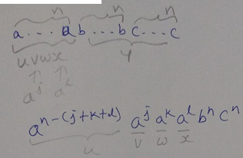
Question
Show that the language L={a^{n}b^{n}c^{n}, n≥0} is not Context Free Language (CFL).
Solution:
Step1: Let L be CFL and let z= a^{n}b^{n}c^{n} ∈ L
Step2: Note that |z|=| a^{n}b^{n}c^{n} |=3n >= n
Split z into uvwxy such that |vwx| ≤ n and |vx| ≥ 1
|vx| =|a^{j}a^{l}|= (j+ l) ≥ 1
|vwx| =|a^{j}a^{k}a^{l}|=(j+k+ l) ≤ n

Slide 101
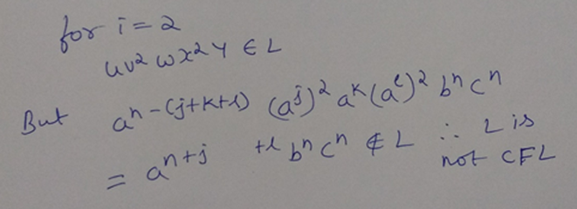
Question
Show that the language L={a^{n}b^{n}c^{n}, n≥0} is not Context Free Language (CFL).
Solution (Contd…):
Step3: For all i, uv^{i}wx^{i}y ∈ L.
Hence L={a^{n}b^{n}c^{n}, n≥0} is not CFL

Slide 102
Question
Show that the language L={WW , W ∈ (a+b)* }is not Context Free Language (CFL).

Slide 103
Show that the language L={WW , W ∈ (a+b)*} is not Context Free Language (CFL). Rough Slide
Solution:
Step1: Let L be CFL and Let z= a^{n}b^{n}a^{n}b^{n} ∈ L
Step2: Note that |z|=| a^{n}b^{n}a^{n}b^{n} |=4n >= n
Split z into uvwxy such that |vwx| ≤ n and |vx| ≥ 1

Slide 104
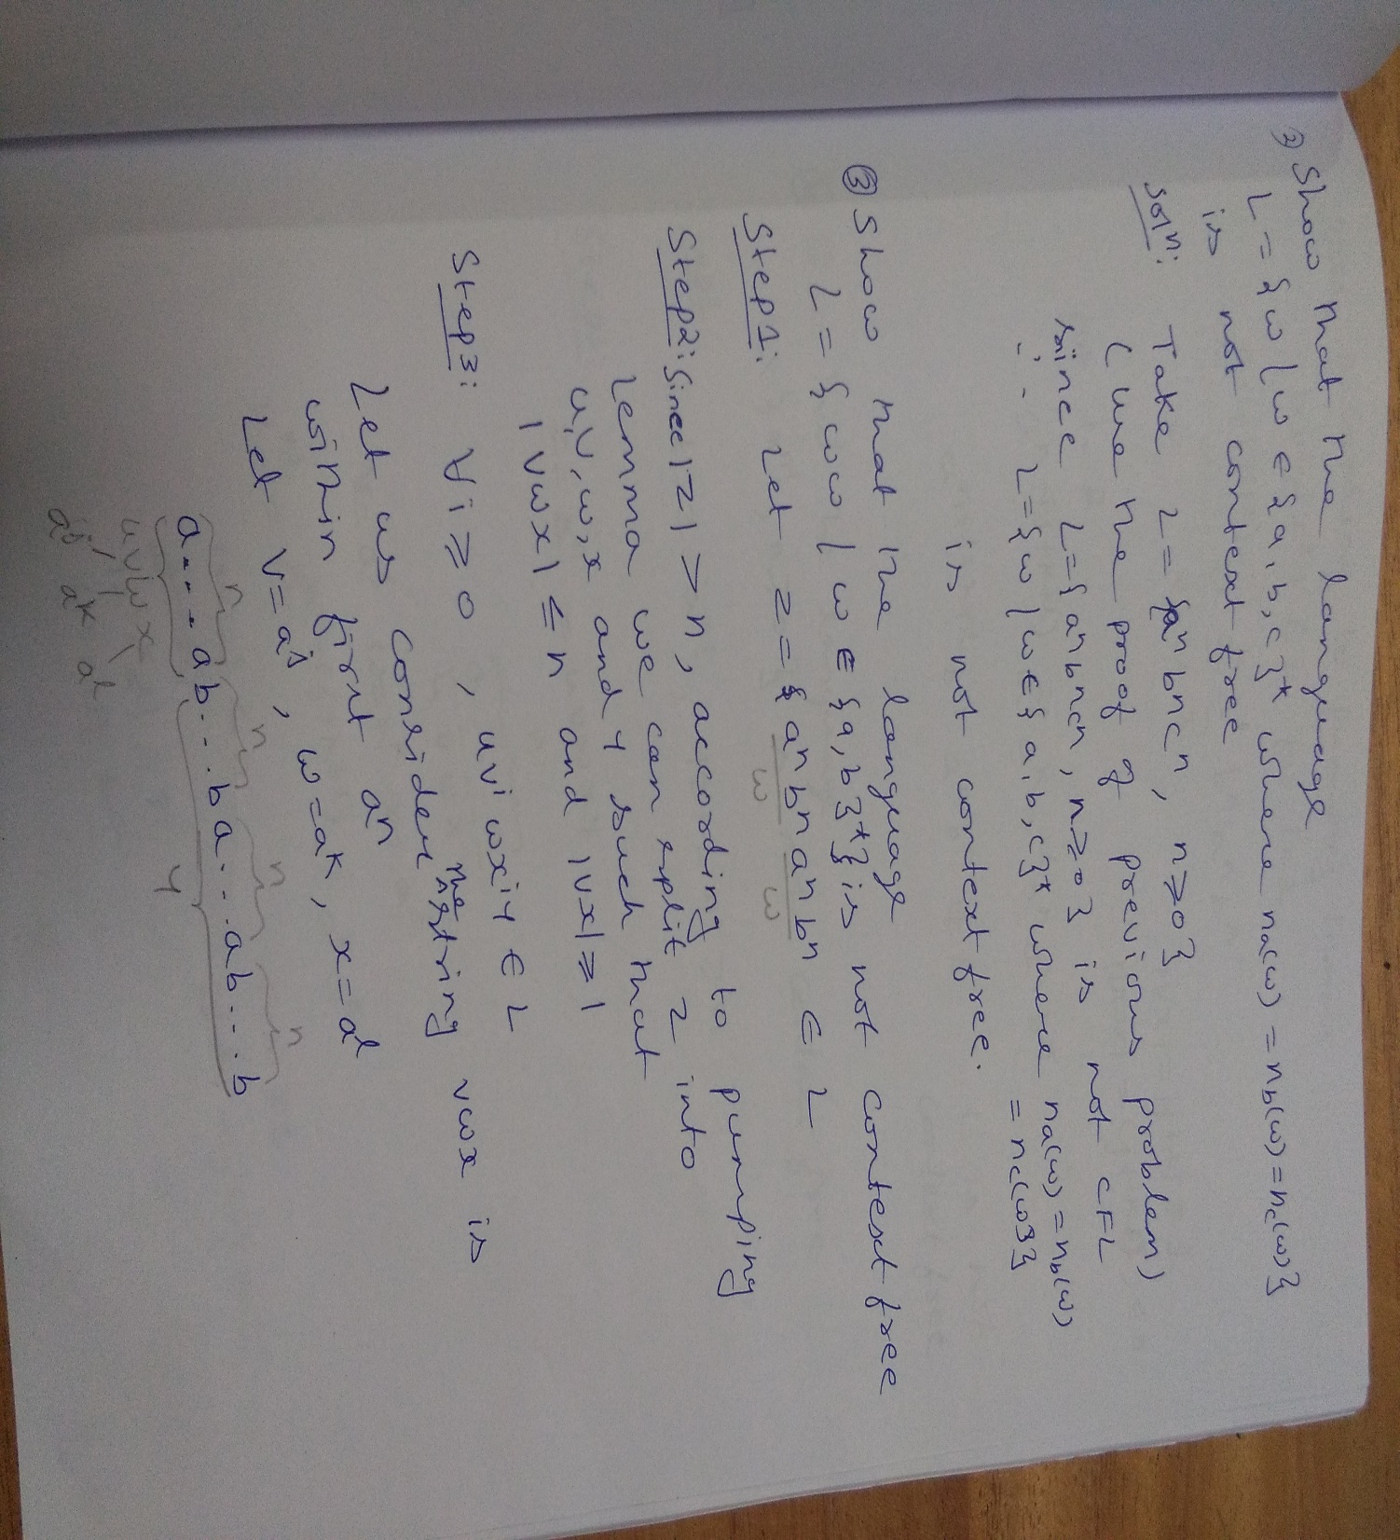

Slide 105
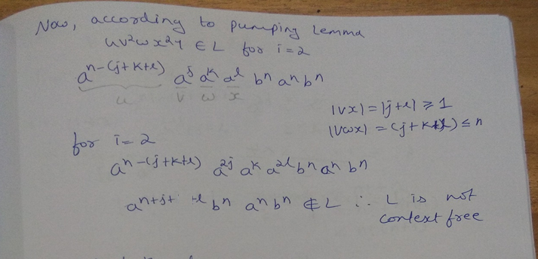

Slide 106
Question
Show that the language L={W , W ∈ (0+1)* , |w| is a perfect square }is not Context Free Language (CFL).

Slide 107
Show that the language L={W , W ∈ (0+1)* , |w| is a perfect square }is not Context Free Language (CFL). Rough Slide
Solution:
Step1: Let L be CFL and Let z= 0^{n2} ∈ L
Step2: Note that |z|=| 0^{n2}|=n² ≥ n
Split z into uvwxy such that |vwx| ≤ n and |vx| ≥ 1
Step 3: For all i, uv^{i}wx^{i}y ∈ L.

Slide 108
Show that the language L={W , W ∈ (0+1)* , |w| is a perfect square }is not Context Free Language (CFL). Rough Slide
Solution:
Step1: Let L be CFL and Let z= 0^{n2} ∈ L
Step2: Note that |z|=| 0^{n2}|=n² ≥ n
Split z into uvwxy such that |vwx| ≤ n and |vx| ≥ 1
Step 3: For all i, uv^{i}wx^{i}y ∈ L.
Let |vx| = m , m ≤ n.
But for i=2,
n² < |uv²wx²y| = n²+m ≤ (n² + n) < (n+1)²
And hence the length is nit a perfect square and therefore string is not in L. This contradiction allows us to conclude that our assumption was wrong and L is not CFL.

Slide 109
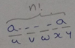
Question
Show that the language L={a^{n!}, n≥0} is not Context Free Language (CFL).
Solution:
Step1: Let L be CFL and it is infinite, Let z= a^{n!} ∈ L
Step2: Note that |z|=| a^{n!}|=n! > n
Split z into uvwxy such that |vwx| ≤ n and |vx| ≥ 1
a^{n!} = a^{n!-(j+k+l )}a^{j}a^{k}a^{l}
v=a^{j} , w=a^{k} , x=a^{l}
|vx| ≥ 1, |a^{j}+a^{l}| =(j+ l )≥ 1
|vwx| ≤ n, |a^{j}+a^{k}+a^{l}| =(j+k+ l ) ≤ n

Slide 110
Question
Show that the language L={a^{n!}, n≥0 is not Context Free Language (CFL).
Solution (Contd..):
Step3: For all i, uv^{i}wx^{i}y ∈ L.
But for i=2,
a^{n!-(j+k+l)}a^{2j}a^{k}a^{2l} = a^{n!+j+l}
|a^{n!+j+l}|= n!+j+l ≤ n!+n
< n!+n!(n)
< n!(n+1)
n! < (n!+j+l) < (n+1)!
Since, (n!+j+l) lies in between n! and (n+1)! ,
the string generated by uv²wx²y = a^{n!+j+l} ∉ L
which is contradiction, hence L is not CFL

Slide 111
Question
Pumping lemma for context free language breaks the strings into
a) Two parts
b) Three parts
c) Five parts
d) Six parts
Notes:
Pumping lemma for context free language breaks the strings into
a) Two parts
b) Three parts
c) Five parts
d) Six parts

Slide 112
Answer
Pumping lemma for context free language breaks the strings into
a) Two parts
b) Three parts
c) Five parts
d) Six parts
Notes:
Pumping lemma for context free language breaks the strings into
a) Two parts
b) Three parts
c) Five parts
d) Six parts

Slide 113
Question
In pumping lemma for context free language
a) We start by assuming the given language is context free and then we get contradict
b) We first convert the given language into regular language and then apply steps on
c) Both (a) and (b)
d) None of these
Notes:
In pumping lemma for context free language
a) We start by assuming the given language is context free and then we get contradict
b) We first convert the given language into regular language and then apply steps on
c) Both (a) and (b)
d) None of these

Slide 114
Answer
In pumping lemma for context free language
a) We start by assuming the given language is context free and then we get contradict
b) We first convert the given language into regular language and then apply steps on
c) Both (a) and (b)
d) None of these
Notes:
In pumping lemma for context free language
a) We start by assuming the given language is context free and then we get contradict
b) We first convert the given language into regular language and then apply steps on
c) Both (a) and (b)
d) None of these

Slide 115
Closure properties of CFL

Slide 116
Closure properties of CFL
Closure properties consider operations on CFL that are guaranteed to produce a CFL
The CFL’s are closed under union, concatenation, closure (star), reversal, homomorphism, inverse homomorphism and substitution.
CFL’s are not closed under intersection and complementation

Slide 117
CFLs are closed under Union Operation
Let L₁ and L₂ be two CFL’s generated by CFGs G₁=(V₁, T₁, S₁, P₁) and G₂ =(V₂, T₂, S₂, P₂)

Slide 118
CFLs are closed under Union Operation
Let L₁ and L₂ be two CFL’s generated by CFGs G₁=(V₁, T₁, S₁, P₁) and G₂ =(V₂, T₂, S₂, P₂)
To get grammar for L₁ ∪ L₂ ?
Add new start symbol S and rules S → S₁ | S₂
We get grammar G = (V, T, P, S) where
V = V₁ ∪ V₂ ∪ { S }, where S ∉ V₁ ∪ V₂
P = P₁ ∪ P₂ ∪ { S → S₁ | S₂ }

Slide 119
CFLs are closed under Union Operation
Let L₁ and L₂ be two CFL’s generated by CFGs G₁=(V₁, T₁, S₁, P₁) and G₂ =(V₂, T₂, S₂, P₂)
To get grammar for L₁ ∪ L₂ ?
Add new start symbol S and rules S → S₁ | S₂
We get grammar G = (V, T, P, S) where
V = V₁ ∪ V₂ ∪ { S }, where S ∉ V₁ ∪ V₂
P = P₁ ∪ P₂ ∪ { S → S₁ | S₂ }
Example:
L₁ = { a^{n}b^{n} | n ≥ 0 } , L₂ = { b^{n}a^{n} | n ≥ 0 }
G₁ : S₁ → aS₁b | ε G₂ : S₂ → bS₂a | ε
L1 ∪ L2 is G = ({S₁, S₂ , S}, {a, b}, P, S) where
P = {P1 ∪ P2 ∪ {S → S₁ | S₂ }}
Union of two CFLs results in CFL.

Slide 120
CFLs are closed under Concatenation Operation
Let L₁ and L₂ be two CFL’s generated by CFGs G₁=(V₁, T₁, S₁, P₁) and G₂ =(V₂, T₂, S₂, P₂)
To get grammar for L₁L₂ ?
Add new start symbol S and rule S → S₁S₂
We get G = (V, T, P, S) where
V = V₁ ∪ V₂ ∪ { S }, where S ∉ V₁ ∪ V₂
P = P₁ ∪ P₂ ∪ { S → S₁S₂ }
Example:
L₁ = { a^{n}b^{n} | n ≥ 0 } with G₁: S₁ → aS₁b | ε
L₂ = { b^{m}a^{m} | m ≥ 0 } with G₂ : S₂ → bS₂a | ε
L₁L₂ = { a^{n}b^{{n+m}}a^{m} | n, m ≥ 0 } with G = ({S, S₁, S₂}, {a, b},
{S → S₁S₂, S₁ → aS₁b | ε, S₂ → bS₂a}, S)
Concatenation of Two CFLs results in a CFL

Slide 121
CFLs are closed under Kleene’s-Closure or Star-Closure Operation
Let L₁ be the CFL generated by CFG G₁=(V₁, T₁, S₁, P₁)
Kleene Star Closure L(G)=(L(G₁))*
Example:
L₁ = {a^{n}b^{n} | n ≥ 0}
(L₁)*= { a^{{n1}}b^{{n1}} ... a^{{nk}}b^{{nk}} | k ≥ 0 and ni ≥ 0 for all i }
To get the grammar for (L₁)*
Add new start symbol S and rules S → SS₁ | ε.
We get G = (V, T, P, S) where
V = V₁ ∪ { S }, where S ∉ V₁
P = P₁ ∪ { S → SS₁ | ε}

Slide 122
Context-free languages are not closed under Intersection
Consider two CFL’s
L₁={a^{n}b^{n}c^{m}, n ≥ 0, m ≥ 0} and
L₂={a^{n}b^{m}c^{m}, n ≥ 0, m ≥ 0}
But L1 ∩ L2 ={a^{n}b^{n}c^{n}, n ≥ 0}, which is not CFL
Thus family of CFL’s is not closed under Intersection operation.

Slide 123
Intersection
The CFL’s are not closed under intersection
Example:
L = {0^{n}1^{n}2^{n}|n ≥ 1} is not context-free.
L1 = {0^{n}1^{n}2^{i} |n ≥ 1,i ≥1 }, L2 = {0^{i}1^{n}2^{n} |n ≥ 1,i ≥1 } are CFL’s with corresponding grammars for L1: S->AB; A->0A1 | 01; B->2B | 2 , and for L2: S ->AB; A->0A | 0; B->1B2 | 12.
However, L = L₁ ∩ L₂
Thus intersection of CFL’s is not CFL

Slide 124
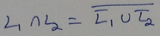
Context-free languages are not closed under Complement
If the family of CFL’s were closed under Complementation then the right side of the above expression would be a CFL for any L₁ and L₂. But this contradicts what we have just shown in previous slide that the intersection of two CFLs is not necessarily Context free.
Consequently, the family of CFL is not closed under Complementation

Slide 125
Set Difference
L₁ and L₂ are CFLs. L₁ - L₂ is not necessarily a CFL
Proof:
L1 = ∑* - L
∑* is regular and is also CFL
But ∑* - L = L^{C}
If CFLs were closed under set difference, then ∑* - L = L^{C} would always be a CFL.
But CFL’s are not closed under complementation

Slide 126
Reversal
The CFL’s are closed under reversal
This means then if L is a CFL, so L^{R} is a CFL
It is enough to reverse each production of a CFL for L, i.e., substitute A→α by A→α^{R}
Example:
L = { a^{n}b^{n} | n ≥ 0 } with P : S → aSb | ε
L^{R} = {b^{n}a^{n} | n ≥ 0 } with P^{R} : S → bSa | ε

Slide 127
Homomorphism
Closure under homomorphism of CFL L for every a∈∑
Suppose L is a CFL over alphabet ∑ and h is a homomorphism on ∑.
Let s be a substitution that replaces every a ∈ ∑, by h(a). i.e., s(a) = {h(a)}.
Then h(L) = s(L).
h(L) ={h(a₁)…h(a_{k}) | k ≥ 0} where h(a_{k}) is a homomorphism for every a_{k} ∈ ∑.

Slide 128
Inverse homomorphism
To recall: If h is a homomorphism, and L is any language, then h⁻¹(L), called an inverse homomorphism, is the set of all strings w such that h(w)∈L
The CFL’s are closed under inverse homomorphism.
Theorem: If L is a CFL and h is a homomorphism, then h⁻¹(L) is a CFL

Slide 129
Inverse homomorphism – proof
Buffer
a
h(a)
Input
h
PDA
Accept/
Reject
Stack

Slide 130
Proof Contd...
After input a is read, h(a) is placed in a buffer.
Symbols of h(a) are used one at a time and fed to PDA being simulated.
Only when the buffer is empty does the PDA read another of its input symbol and apply homomorphism to it.

Slide 131
Proof Contd...
Suppose h applies to symbols of alphabet Σ and produces strings in T*.
Let PDA P = (Q, T, Γ, δ, q₀, Z₀, F) that accept CFL L by final state.
Construct a new PDA P′ = (Q′, Σ, Γ, δ′, (q₀, ε), Z₀, F X {ε}) to simulate language of h⁻¹(L), where
Q′ is the set of pairs (q, x) such that
q is a state in Q
x is a suffix of some string h(a) for some input string a in Σ

Slide 132
Proof Contd...
δ′ is defined by
δ′((q, ε), a, X) = {((q, h(a)),a,X)}
If δ(q, b, X) = {(p, γ)} where b∈T or b = ε then δ′((q, bx), ε, X) = {((p, x), γ)}
The start state of P’ is (q0, ε)
The accepting state of P′ is (q, ε), where q is an accepting state of P.
(q₀,h(w),Z₀)|-*P (p,ε,γ) iff ((q₀,ε),w,Z₀) |-*P′ ((p, ε), ε, γ)
P accepts h(w) if and only if P′ accepts w, because of the way the accepting states of P′ are defined.
Thus L(P′)=h⁻¹(L(P))

Slide 133
Intersection with RL
Theorem: If L is CFL and R is a regular language, then L ∩ R is a CFL.
FA
Accept/
Reject
AND
PDA
Stack

Slide 134
Intersection with RL Proof
P=(Q_{P}, ∑, Γ, δ_{P}, q_{P}, Z₀, F_{P}) be PDA to accept CFL by final state
A=(Q_{A}, ∑, δ_{A}, q_{A}, F_{A}) be a DFA for RL
Construct PDA P′ = (Q, ∑, Γ, δ, q_{o}, Z₀, F) where
Q = Q_{p} X Q_{A}
q_{o}= (q_{p}, q_{A})
F = (F_{P} X F_{A})
δ is in the form δ((q, p), a, X) = ((r, s), γ) such that
s = δ_{A}(p, a)
(r, γ) is in δ_{P}(q, a, X)

Slide 135
Proof Contd…
For each move of PDA P, we make the same move in PDA P′ and also we carry along the state of DFA A in a second component of P′.
P′ accepts a string w iff both P and A accept w.
w is in L ∩ R.
The moves ((q_{p}, q_{A}), w, Z) |-*P′ ((q, p), ε, γ) are possible iff (q_{p}, w, Z) |-*P (q, ε, γ) moves and p = δ*(q_{A}, w) transitions are possible.

Slide 136
Set Difference with RL
For a CFL’s L, and a regular language R.
L - R is a CFL.
Proof:
R is regular and R^{C} is also regular
L - R = L ∩ R^{C}
Complement of Regular Language (R^{C} ) is regular
Intersection of a CFL and a regular language is CFL
CFL and Regular language are closed under intersection.

Slide 137
Complementation
L^{C} is not necessarily a CFL
Proof:
Assume that CFLs were closed under complement.
If L is a CFL then L^{C} is a CFL
Since CFLs are closed under union, L₁^{C} ∪ L₂^{C} is a CFL
And by our assumption (L₁^{C} ∪ L₂^{C}) ^{C} is a CFL
But (L₁^{C} ∪ L₂^{C}) ^{C} = L₁ ∩ L₂ which we just showed isn’t necessarily a CFL.
Contradiction!

Slide 138
Substitution
Each symbol in the strings of one language is replaced by an entire CFL language
Useful in proving some other closure properties of CFL
Example: S(0) = {a^{n}b^{n}| n ≥1}, S(1) = {aa, bb} is a substitution on alphabet Σ ={0, 1}.

Slide 139
Substitution
Theorem: If a substitution s assigns a CFL to every symbol in the alphabet of a CFL L, then s(L) is a CFL.
Proof
Let G = (V, ∑, P, S) be grammar for L
Let G_{a}= (V_{a}, T_{a}, P_{a}, S_{a}) be the grammar for each a ∈ ∑ with V∩V_{a} =φ
G′= (V′, T′, P′, S) for s(L) where
V′ = V ∪ V_{a}
T′ = union of T_{a} for all a ∈ ∑
P′ consists of
All productions in any P_{a} for a ∈ ∑
In productions of P, each terminal a is replaced by S_{a}
A detailed proof that this construction works is in the reader.
Intuition: this replacement allows any string in La to take the place of any occurrence of a in any string of L.

Slide 140
Example (1)
L = {0^{n}1^{n}| n ≥1}, generated by the grammar S→0S1|01,
s(0) = {a^{n}b^{m}|m≤ n}, generated by the grammar S→aSb|A; A→aA| ab,
s(1)={ab, abc}, generated by the grammar S → abA, A → c |ε
Rename second and third S’s to S₀ and S₁ respectively. Rename second A to B. Resulting grammars are:
S→0S1 | 01
S₀→aS₀b | A; A→aA | ab
S₁→abB; B→c | ε

Slide 141
Example(1) Contd...
In the first grammar replace 0 by S₀ and 1 by S₁. The combined grammar:
G′ = ({S, S₀, S₁, A, B}, {a, b}, P′, S),
where P′ = {S → S₀SS₁ | S₀S₁, S₀→ aS₀b | A, A →aA | ab, S₁→abB, B→ c | ε}

Slide 142
Application of Substitution
Closure under union of CFL’s L₁ and L₂
Closure under concatenation of CFL’s L₁ and L₂
Closure under Kleene’s star (closure * and positive closure ⁺) of CFL’s L₁
Closure under homomorphism of CFL L_{i} for every a_{i}∈ ∑

Slide 143
Thanks for Listening

Slide 144
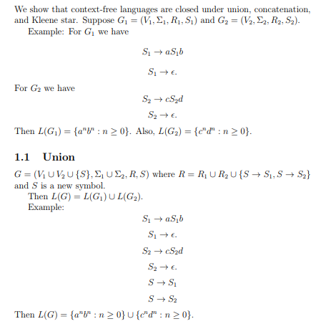
Closure properties of CFG’s

Slide 145
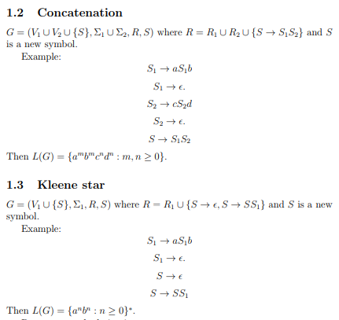
Closure properties of CFG’s

Slide 146
Question
The context free languages are closed under: a) Intersection b) Complement c) Kleene’s-Closure d) None of the mentioned

Slide 147
Question
The context free languages are closed under: a) Intersection b) Complement c) Kleene’s-Closure d) None of the mentioned

Slide 148
Question
Context free languages are not closed under: a) Intersection b) Complement c) All of the mentioned

Slide 149
Question
Context free languages are not closed under: a) Intersection b) Complement c) All of the mentioned

Slide 150
Applications of Context Free Grammars (CFG)
YACC (Yet Another Compiler-Compiler)
Mark up language (HTML)
XML (Extensible Markup Language)

